Slide 1
Healmet Detection and Reporting
UQ22CA741A PHASE-II
PRESENTATION-1
Student Details:
Name: Mr. Adarsh Y Ulvekar
SRN: PES1PG22CA008
Guide Details:
Name: Ms. Pavithra T S
Assistant professor
PES UNIVERSITY

Slide 2
Abstract
Helmet detection is a critical aspect of road safety, as it has been shown to reduce the risk of head injuries Helmet detection systems can be used to identify rider who are not wearing Helmet. This can help to increase helmet usage and reduce the number of motorcycle accidents.
This System will detect the rider with no helmet and record the details of vehicle and will generate the report that will containing details like rider image, vehicle number, name, phone number and address. This report will be submitted to the traffic controller and Rider will be reported through SMS.

Slide 3
Functionalities
Detect the Motorcycle rider wearing no Helmet with Object detection.
Vehicle and rider image extraction with image processing.
Convert vehicle number from image to text.
Fetch the details of vehicle and generate report with details.
Notify rider regarding violation through SMS.

Slide 4
Domain
This project falls under “Machine Learning” domain.
The application will be based on “Traffic violation Software”.

Slide 5
Problem Scenerio
Traffic inspector absence on the scene.
Manual monitoring over the vehicle.
Rider unawareness of the rule violation.
Lack of evidence for penalties.

Slide 6
Application in real world
Traffic Controller System:This systems utilize various technologies, such as image processing, machine learning, and SMS services to identify and detect individuals riding motorcycles without helmets.

Slide 7
Purpose
To promote motorcycle helmet use and reduce the number of helmet related accidents injuries.
Automate motorcycle helmet violation detection and streamline enforcement processes.
Advance the field of traffic management and create a safer transportation ecosystem through technological solutions.
To improve traffic safety and efficiency by addressing dangerous behavior and promoting compliance with traffic laws.

Slide 8
Scope
Identify motorcycle riders through the input video.
License Plate Extraction and Recognition only extracted if no helmet is detected.
System may not perform perfectly in all scenarios like obscured plates, challenging lighting.
Vehicle Information should be present in the database for extraction
Data privacy needs to be addressed if storing rider information.

Slide 9
Literature Survey
1.Research Paper:
Helmet, Number Plate Detection and Stolen vehicle recognition using Machine Learning [2023]
Author: Mrs. Vinaya Kulkarni, Dhanashree Pawar, Sanskruti Talwekar,Rupali Bharambe.
Domain Survey:
Terminologies:
Video size/aspect ratio analysis
Image Classification using CNN
Head region extraction and feature analysis
Optical character recognition (OCR)

Slide 10
Literature Survey
Protocols:
Video input: The system take a video as input.
Video size/aspect ratio analysis: The system analyze the video's size and aspect ratio.
Image classification using CNN: The system use a CNN to classify the content of each video frame
Head region extraction and feature analysis: The system extract the head region from each frame and analyze features.
Optical character recognition: The system use OCR to extract text from each frame.
Output: The system would output the results of the analysis
Survey-01: https://www.researchgate.net/publication/371449852

Slide 11
Literature Survey
2. Research Paper:
real-time automatic helmet detection of motorcyclists in urban traffic [2021]
Author: Wei Jia ,Shiquan Xu ,Zhen Liang, Yang Zhao, Hai Min, Shujie L,i Ye Yu
Domain Survey:
Terminologies:
Real-time Video Surveillance
Bounding Box and YOLOv5
CNN Techniques
Helmet Presence Label

Slide 12
Literature Survey
Protocols:
Input: Real-time video surveillance images.
Motorcycle Detection YOLOv5: Identify and locate motorcycles in the image using the improved YOLOv5 algorithm.
Helmet Detection YOLOv5: Use YOLOv5 to analyze each region to determine if the rider is wearing a helmet.
Output: Real-time data on detected motorcycles and helmet usage by riders
Survey-02: https://www.researchgate.net/publication/352858513

Slide 13
Literature Survey
3.Research Paper:
Design and Development of Automatic Detection System for Motorcyclists without Helmet using Machine Learning [2023]
Author: K. N. Hande, Pooja Takliker , Lekha Bhoyar , Pranjali Bawankar, Piyush Navghare
Domain Survey:
Terminologies:
OpenCV for image processing
Detect the Vehicle number plate from the Captured image
HAAR cascade
Recognition of each character(OCR)

Slide 14
Literature Survey
Protocols:
Input: Capture or obtain images of individuals, either from live video feeds or pre-recorded footage.
Image Preprocessing: Prepare the images for analysis by resizing, converting to grayscale.
Helmet Detection: Use a suitable object detection method, potentially a HAAR cascade classifier, to locate and identify helmets within the images.
Classification: Classify the detected helmets.
OCR : Extract text from helmets, such as license plate numbers or identification codes.
Output: Display and store the results of the detection process.
Survey-03: https://doi.org/10.32628/IJSRSET23102117

Slide 15
Literature Survey
4. Research Paper:
automatic number plate detection for motorcyclists riding without helmet [2023]
Author: Mamidi Kiran Kumar , Chidrala Sanjana , Farha Shireen , Dursheti Harichandana
Domain Survey:
Terminologies:
User interface
Location of ROIs
Image pre-processing of number plate resizing, convert to gray scale & Denoising the image
Alert generation using pyWhatkit.

Slide 16
Literature Survey
Protocols:
Input: input images or video frames containing potential helmets.
Image Pre-processing: Resize or crop images to focus on relevant areas.
Helmet Detection: object detection algorithms YOLOv5, Haar cascades to identify helmets.
ROI Extraction : Isolate the region of interest around each helmet for further analysis.
Classification : categories to detected helmets.
Alert Generation: notifications based on detection results Use libraries like pyWhatkit for alert generation.
Survey-04: https://doi.org/10.1051/e3sconf/202343001038

Slide 17
Literature Survey
5. Research Paper: HELMET DETECTION USING MACHINE LEARNING [2022]
Author: Chaitanya Srusti, Vibhav Deo, Dr. Rupesh C. Jaiswa
Domain Survey:
Terminologies:
Background subtraction
YOLOv5
Contour detection
Optical character recognition (OCR)

Slide 18
Literature Survey
Protocols:
Background Subtraction: Separate moving objects from the background.
YOLOv5 Object Detection: Apply the YOLOv5 algorithm to identify and locate helmets.
Contour Detection: Identify the outlines or edges of objects in the image.
Optical Character Recognition: extract text from no helmets license plate number.
Summary:
Using open-source library for Background subtraction, YOLO for object tracking, speed estimation, detect helmet using CNN classification and extracting number plate.
Survey-05: https://www.researchgate.net/publication/371783195

Slide 19
Tools and Technology
Hardware Requirements:
CPU: Intel Core i5 or AMD Ryzen 5.
RAM: 8GB or more DDR3 RAM.
Storage: 256GB SSD or similar for efficient data access.
Software Requirements:
Programming language: Python
Frameworks: PyTorch, TensorFlow, YOLO
Libraries: OpenCV, NumPy, Easy OCR
Data: XML
API: Twilio
IDE: Visual Studio, Jupyter Notebook

Slide 20
System Requirements
System Input:
Login
Video File
Registration number
System Output:
Helmet Detection
Number Plate Extraction
Generate Reports
Rider Image
Number plate image
Name , Address, Registration no, Phone no
SMS Notification

Slide 21
Non-functional requirements
Performance: Minimal latency in generating reports and sending SMS alerts.
Reliability : it provides a good amount of accuracy ,ensuring it correctly reflects the detected helmet
User Interface : provide user with responsive page for easy evaluation with rider image, number plate image, name, address, phone number.
Access control: The system enforce access controls to restrict unauthorized access to vehicle imformation.

Slide 22
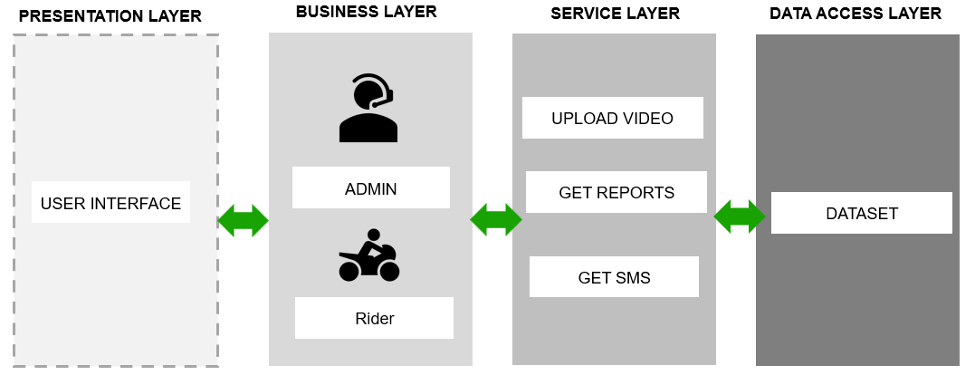
Architecture Diagram

Slide 23
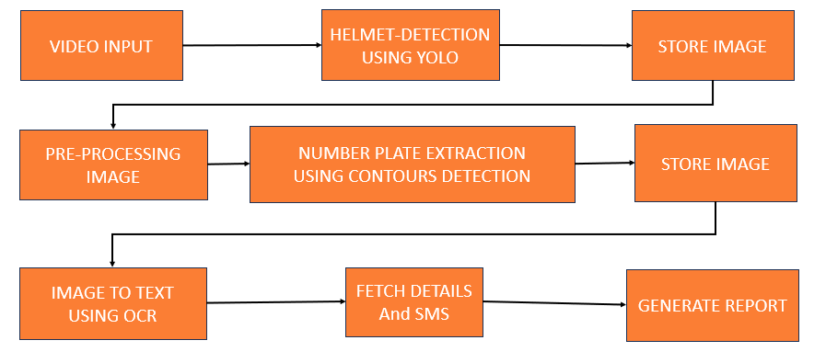
BLock Diagram

Slide 24
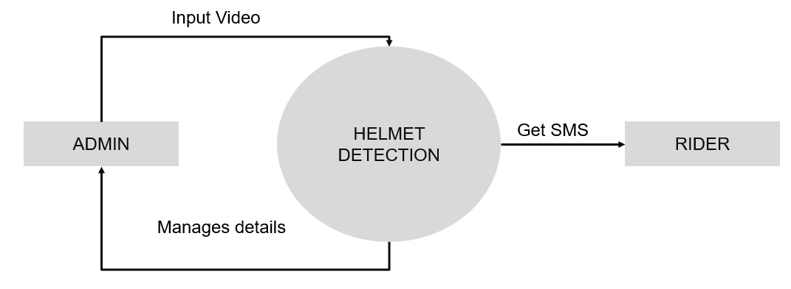
Context Diagram

Slide 25
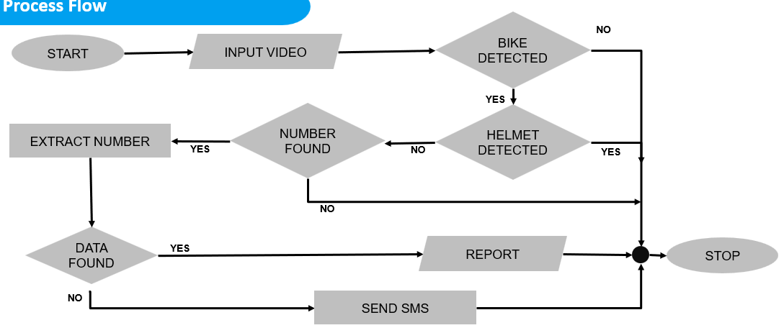
Process FLow Diagram

Slide 26
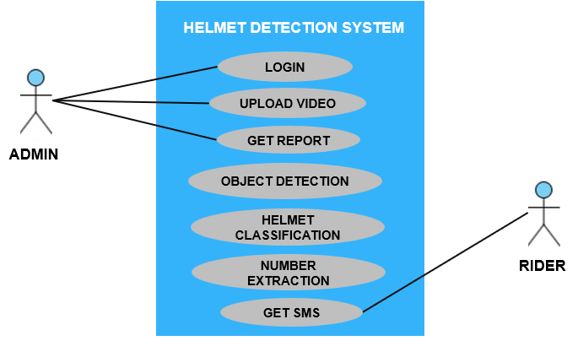
Use case Diagram

Slide 27
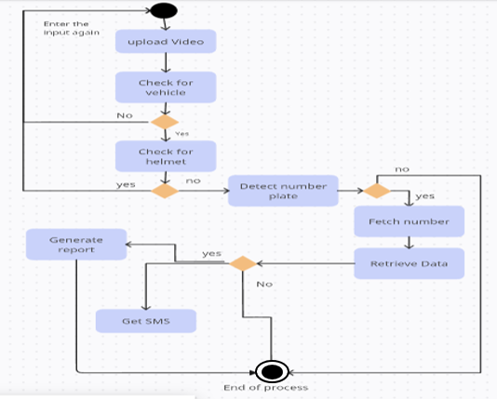
Activity Diagram

Slide 28
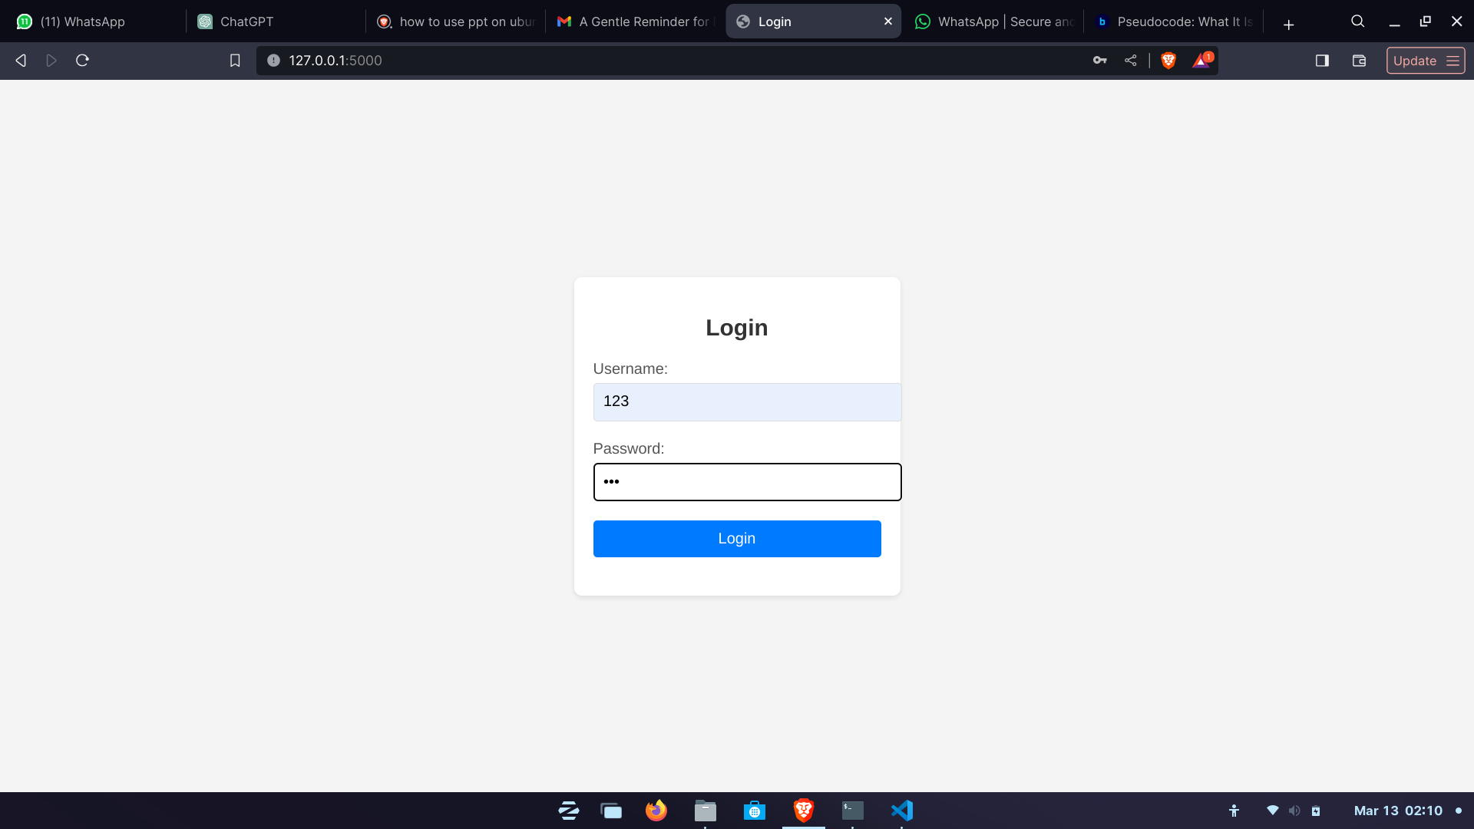
Pseudo Code
Login page:
GET entered username and password from the form fields. #When the user submits the login form:
SET username==123 and password==123
IF the entered username is "123" and the entered password is "123":
Redirect the user to the dashboard page.
ELSE:
Display an alert message indicating that the username or password is incorrect.

Slide 29
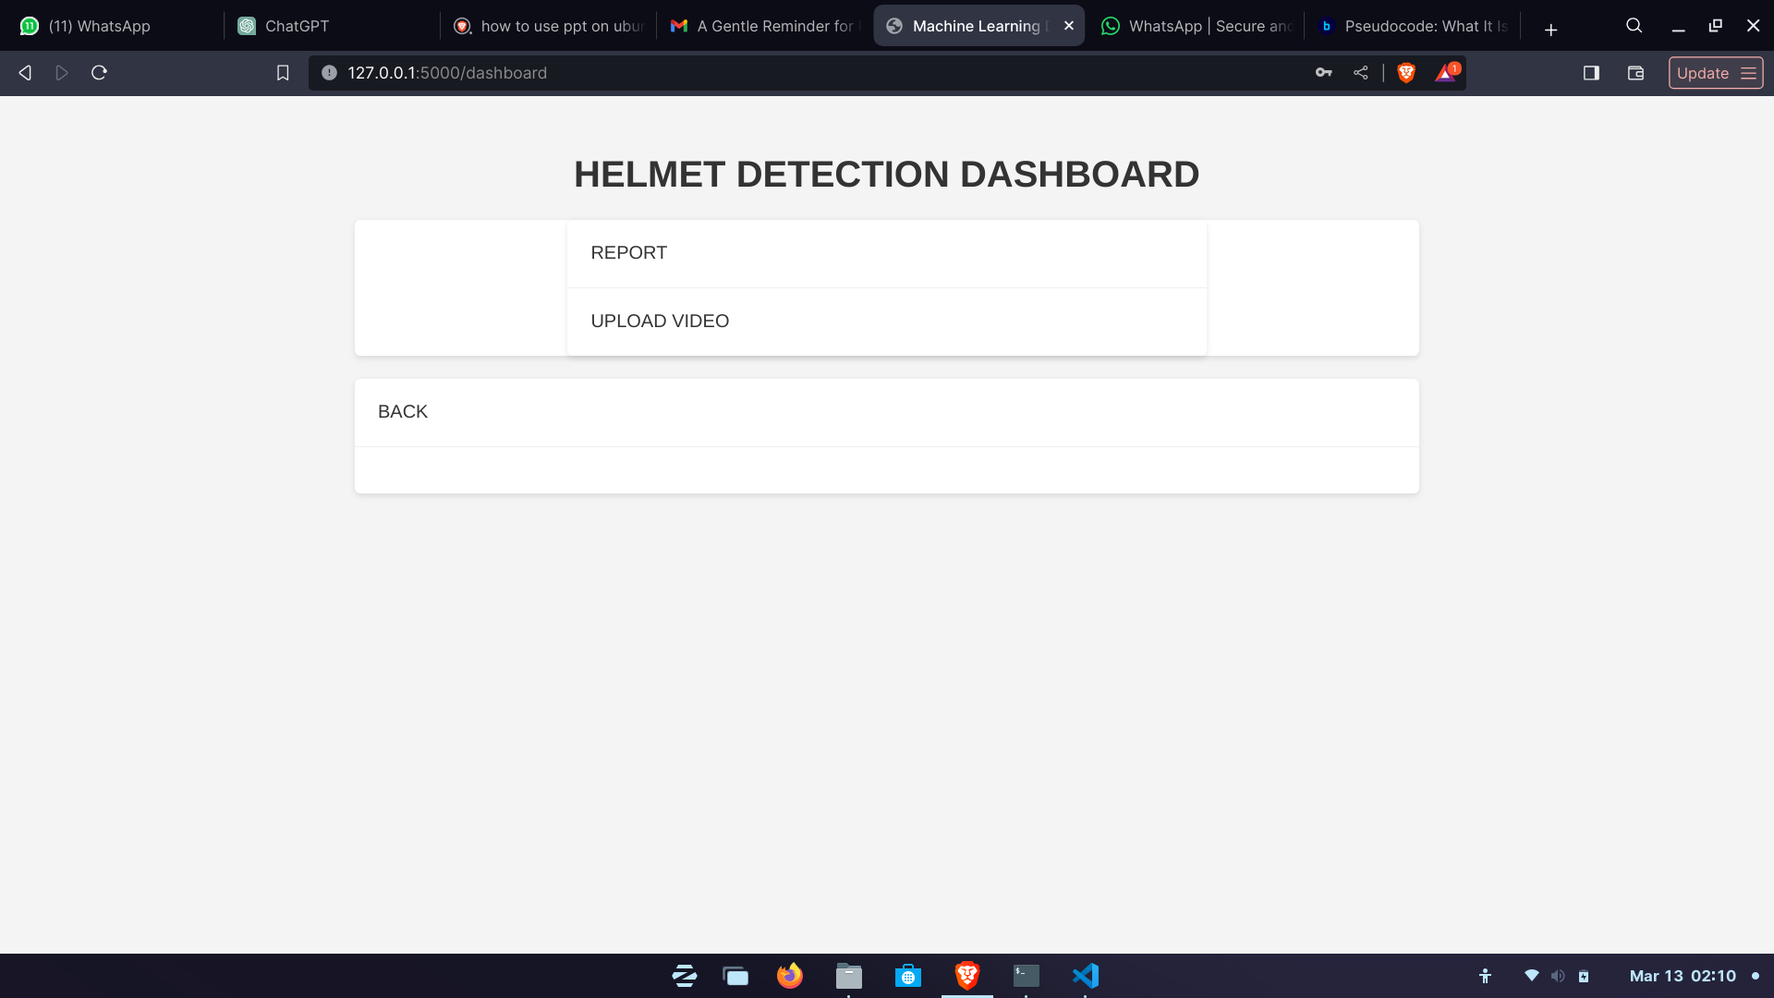
Pseudo Code
Dashboard page:
Display the header "HELMET DETECTION DASHBOARD".#When the webpage is loaded
Display a navigation menu:
Option 1: "REPORT" - Links to /report.
Option 2: "UPLOAD VIDEO" - Links to /upload.
Display a user settings section:
Option 1: "BACK" - Links to login

Slide 30
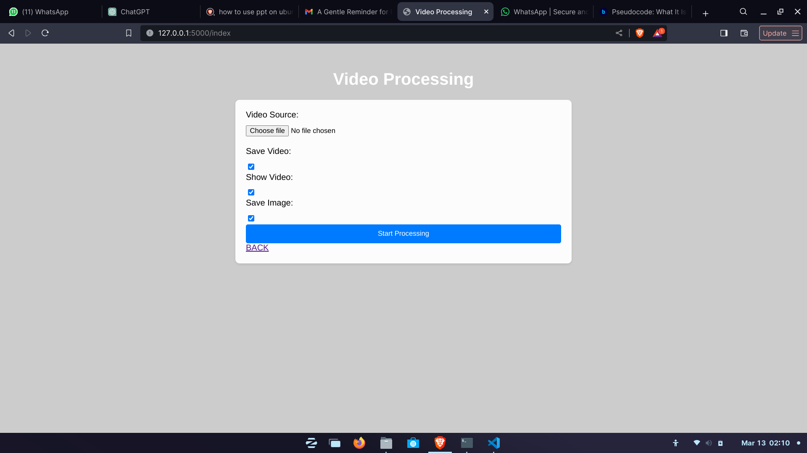
Pseudo Code
Processing page:
GET video_source #Input and Request
IF save_video:
#save in folder
IF show_video:
#display the output
IF save_image:
#save the output
GET button==clicked
main.py() #start processing video
DISPLAY output

Slide 31
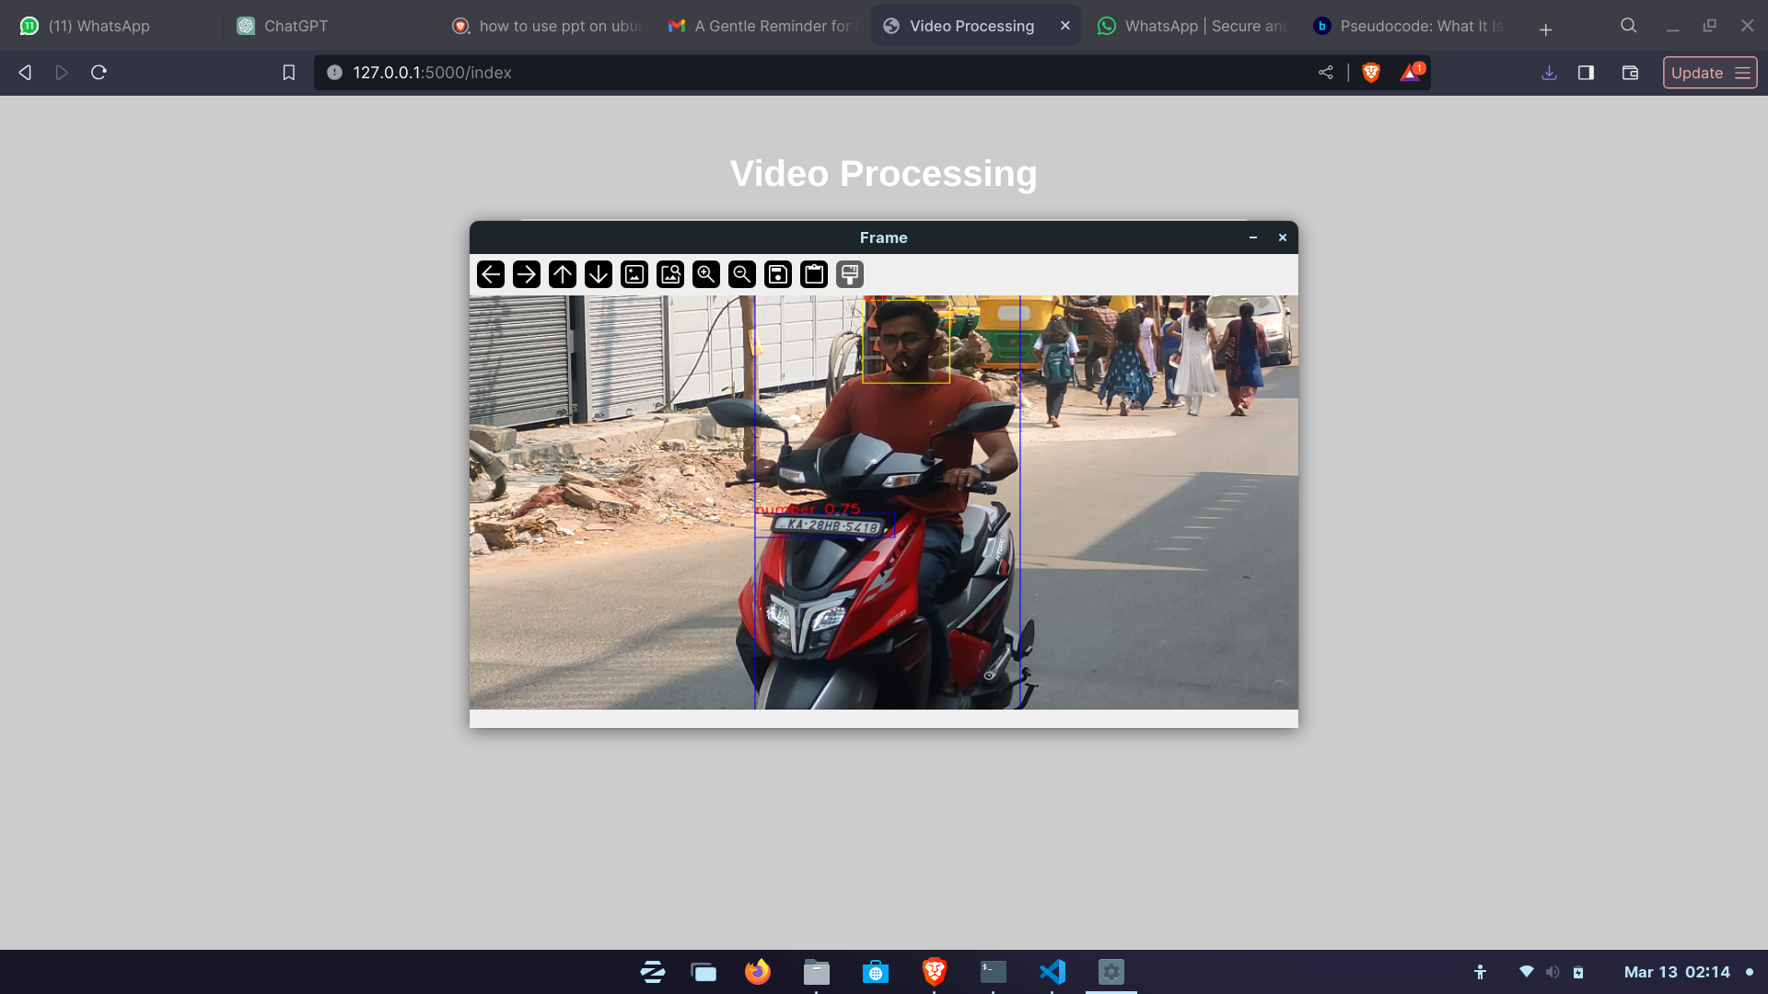
Pseudo Code
Output:
#setting up the sources
set output_folder to 'output_texts'.
If the output folder doesn't exist:
Create the output folder.
Open a video capture object using the source_path.

Slide 32
Pseudo Code
While the video capture is open: #resizing frame (800, 480)
Read the next frame from the video capture.
If the frame is successfully read:
Resize the frame to the specified frame_size.
Create a copy of the original frame.
Perform object detection on the frame, resulting in a list of detection results.
Initialize empty lists for rider, head, and number plate detections. #creating null value List
For each detection result:
Parse the result to extract coordinates and class.
Add the result to the corresponding list based on class.
For each rider detection: #creating Bounding box
Generate a timestamp string.
For each head detection:
If the head is inside the rider's bounding box:
Extract the head image.
Classify the image to check for a helmet.

Slide 33
Pseudo Code
Depending on the classification result: #Classifcation
Draw a rectangle around the head with appropriate color.
Draw text indicating the helmet presence.
If helmet present, draw green rectangle, else red.
If prediction is uncertain, draw yellow rectangle.
Save the rider's image if helmet is absent.
For each number plate detection: #Extract number plate
If the number plate is inside the rider's bounding box:
Extract the number plate image.
Save the image with timestamp and confidence score.
If saving video is requested: #Requested output
Write the processed frame to the output video.
If saving image is requested:
Save the processed frame as 'saved_frame.jpg'.

Slide 34
Pseudo Code
if showing video is requested:
Resize the frame for display.
Show the frame in a window.
Check for key press:
If 'q' is pressed, exit the loop.
If the frame cannot be read:
Exit the loop.
Release the video capture object.
If saving video is requested:
Release the video writer object.
Close all OpenCV windows.
Redirect to '/fetch_images'.

Slide 35
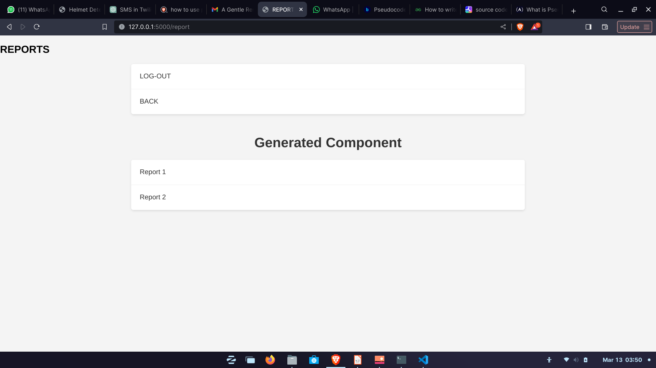
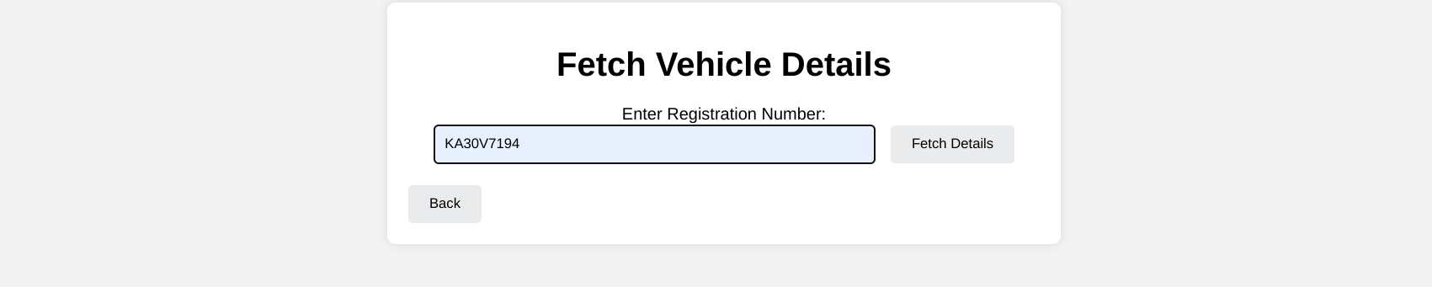
Pseudo Code
Reporrt:

Slide 36
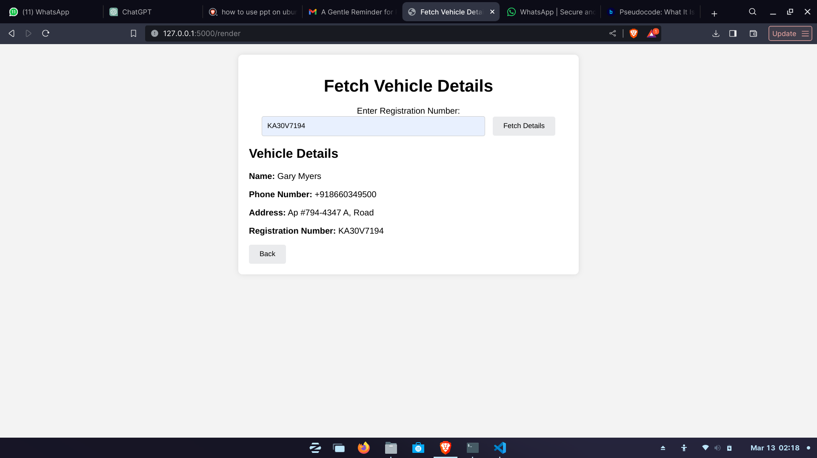
Pseudo Code
Report:

Slide 37
Pseudo Code
Upon receiving a GET request at '/fetch_vehicle_details': #Get parameter for registration
Retrieve the registration number from the request parameters.
If the registration number is not provided:
Return a JSON response with an error message and status code 400.
Try to parse the XML file and get its root element.
Initialize an empty dictionary to store vehicle details.
Iterate through each record element in the XML root: #Matching value with XML
If the registration number of the record matches the provided registration number:
Populate the vehicle details dictionary with the name, phone number, address, and registration number.
Break the loop.
If vehicle details are not found:
Return a JSON response with an error message and status code 404.
Return a JSON response with the vehicle details.

Slide 38
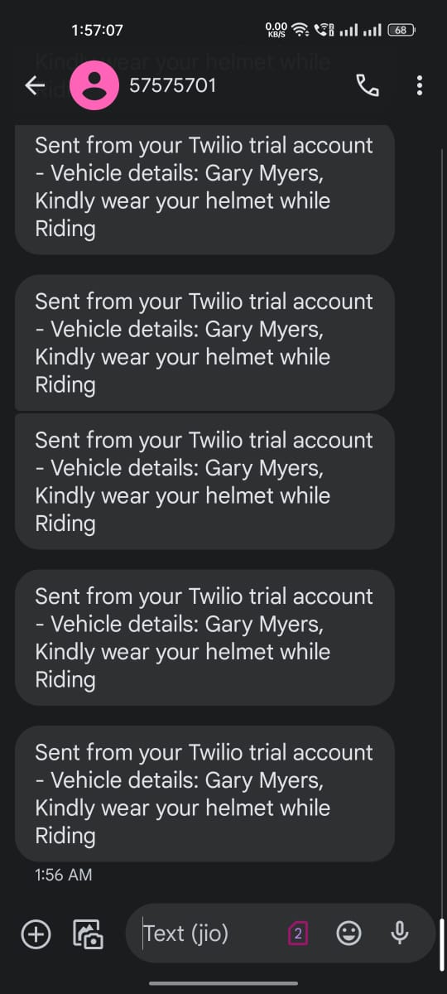
Pseudo Code
SMS:
Upon receiving a POST request at '/send_sms': #send SMS for the number
Retrieve the phone number and message from the request form data.
Try to send an SMS using Twilio client with the provided message and phone number.
If successful:
Return a JSON response indicating success along with the message SID.
If an error occurs:
Return a JSON response indicating failure along with the error message.

Slide 39
Thank You
Adarsh Y Ulvekar
PES University
adarshulvekar49@gmail.com

